Slide 1
Robotics
Probablistic Robotics

Slide 2
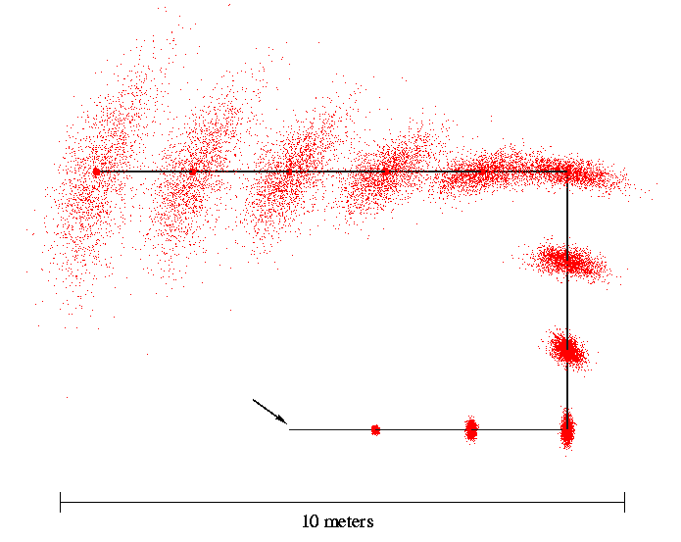
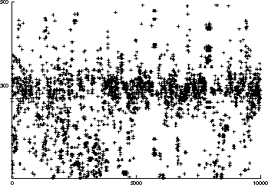
Probabilistic robotics
How to deal with uncertain information?

Slide 3
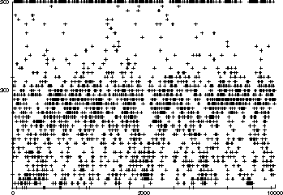
The Real World: Noisy Sensor Data
Noisy measurements
E.g. Measured distances for expected distance of 300 cm.
Sonar
Laser

Slide 4
The Real World: Noisy Motion Data
accumulation of pose estimation errors
Start

Slide 5
Probabilistic Robotics
Accept that motion, manipulation and sensing all give noisy and uncertain results
Explicitly represent uncertainty using the calculus of probability theory

Slide 6
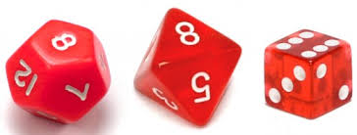
Probability
What is the probability of throwing a 6?
P(6) = ?
What is it after throwing a 2 ?
P(6|2) = ?

Slide 7
Probability
Probability that X has value x: P(X=x), or P(x)
where 0 <= P(x) <= 1
Probability that X=x, given that Y=y: P(x|y)
Conditional probability
Probability that X=x and Y=y: P(x,y)

Slide 8
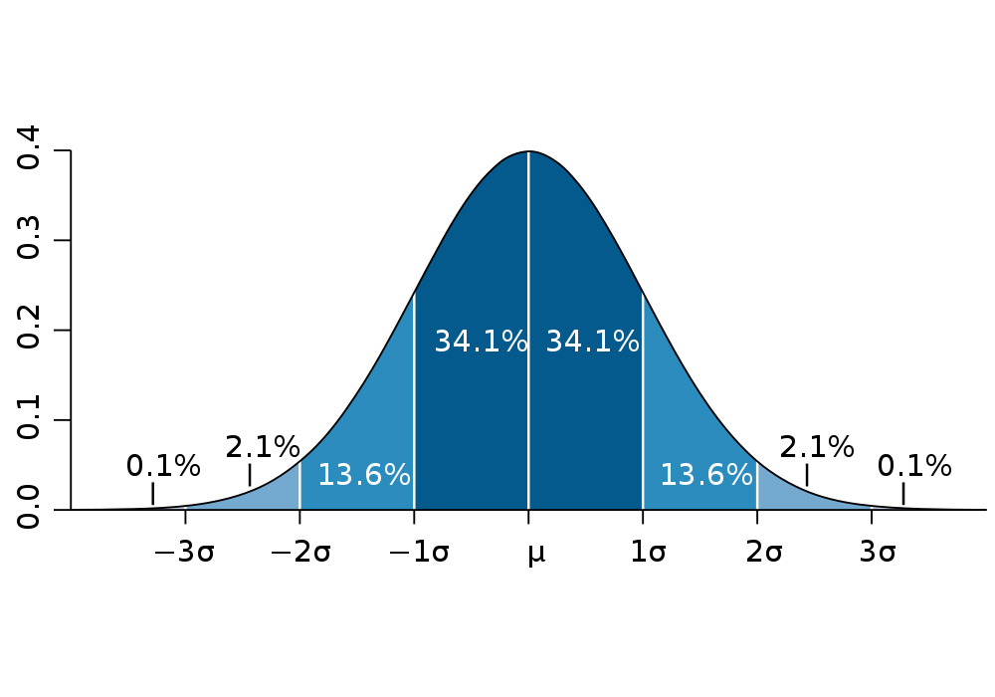
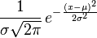
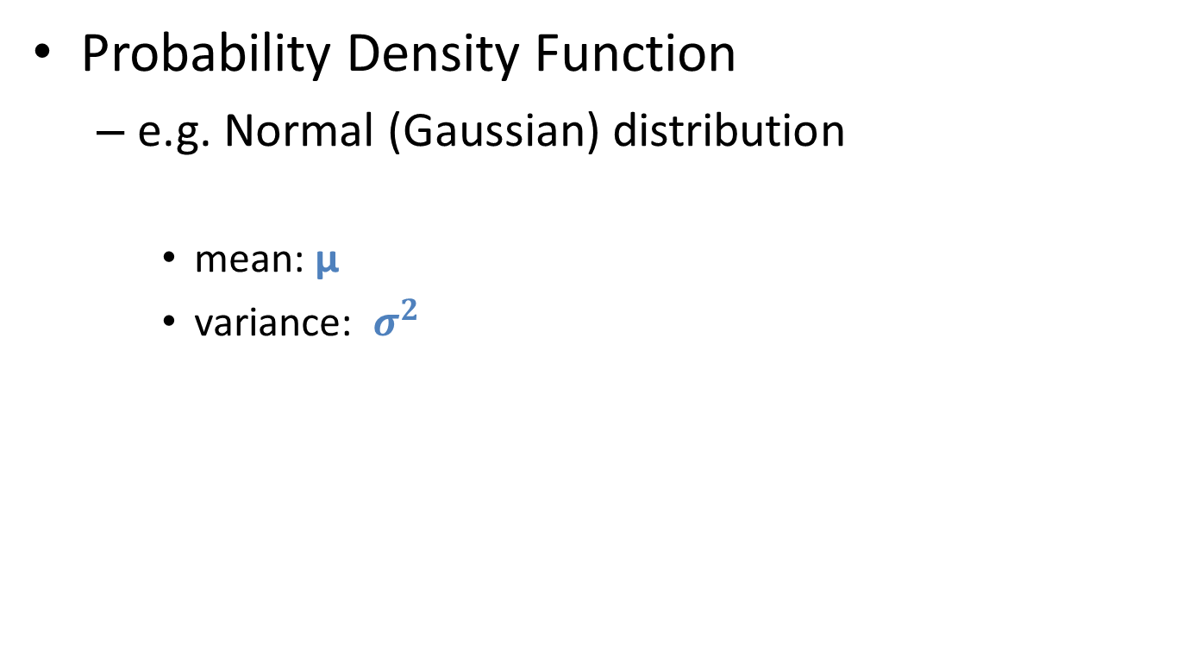
Probability Distribution
Probability Density Function
e.g. Normal (Gaussian) distribution
mean: μ
variance: $σ^{2}$
http://en.wikipedia.org/wiki/Normal_distribution
p(x)
x
https://en.wikipedia.org/wiki/68%E2%80%9395%E2%80%9399.7_rule

Slide 9
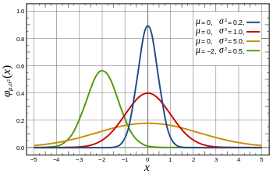
Mean and Variance

Slide 10
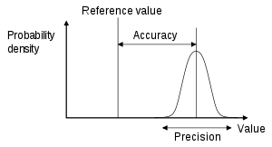
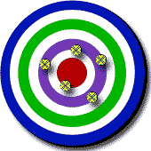


Accuracy and Precision
https://en.wikipedia.org/wiki/Accuracy_and_precision

Slide 11
Bayes Rule
posterior

Slide 12
LOCALIZATION
Where am I?

Slide 13
What do we need?
A Map
Representation?
Sensors to look around
Which sensor(s)?
A way to determine location from sensor data
How?

Slide 14

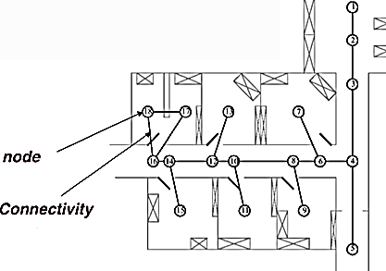
Map
Grid
fine
Topological
course

Slide 15
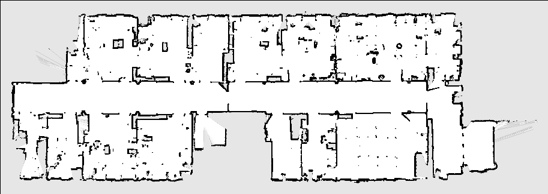
Occupancy Grid Map
http://www.ros.org/doc/api/nav_msgs/html/msg/OccupancyGrid.html
Each cell: probability that it is occupied

Slide 16
Sensing
Measuring distances to obstacles

Slide 17
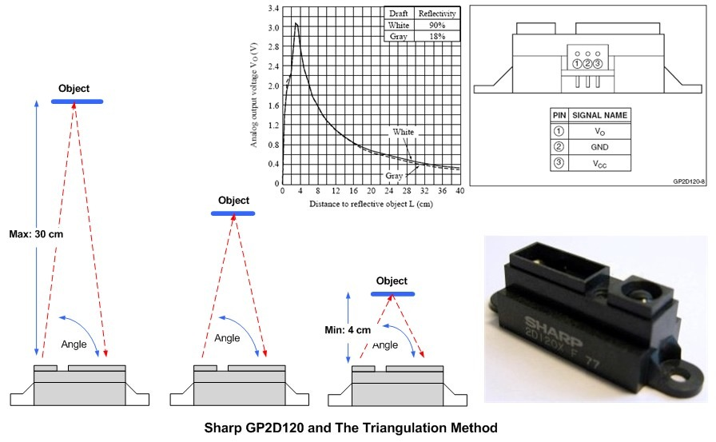
IR Sensor
Triangulation with IR Light

Slide 18
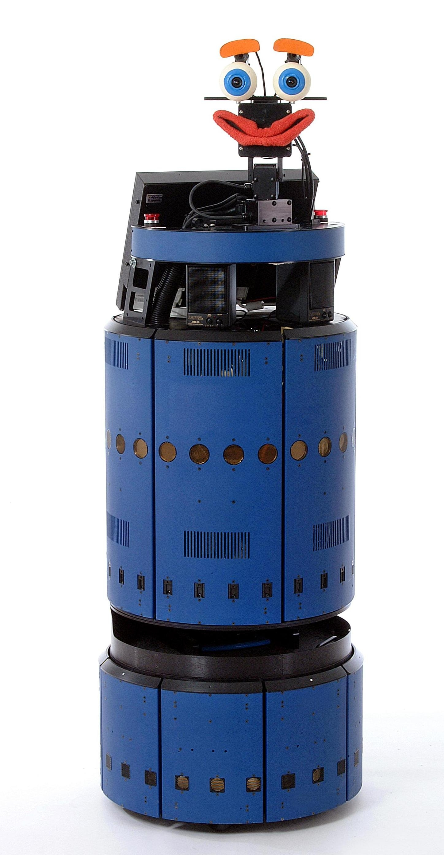
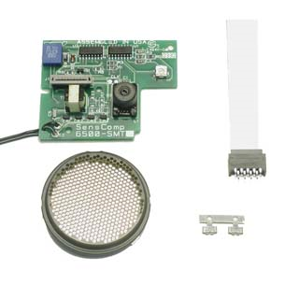
Ultrasonic Sensor
Emit an ultrasound signal
Wait until they receive the echo
Distance from Time of flight
Relatively wide beam → low resolution
Polaroid 6500

Slide 19
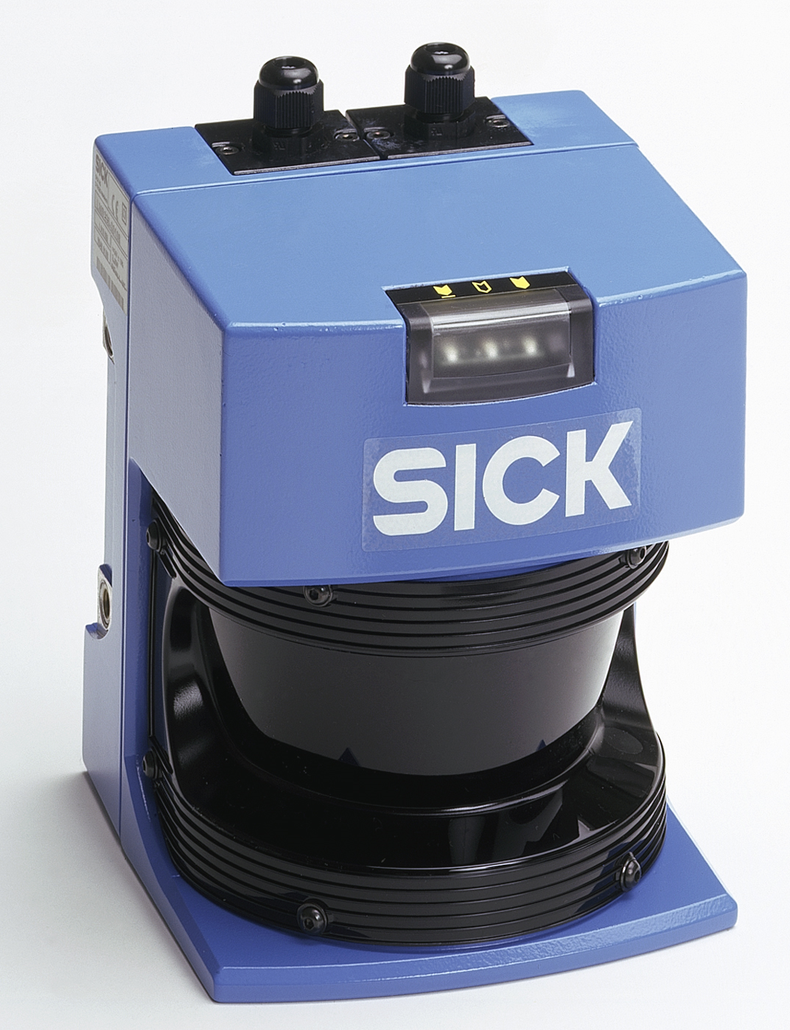
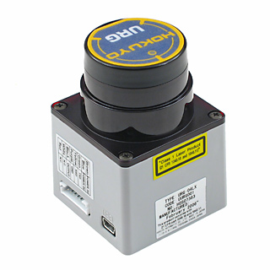
Laser Range Scanner
Fine laser beams → high resolution

Slide 20
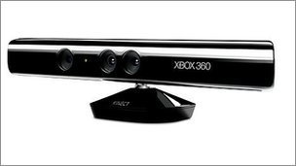
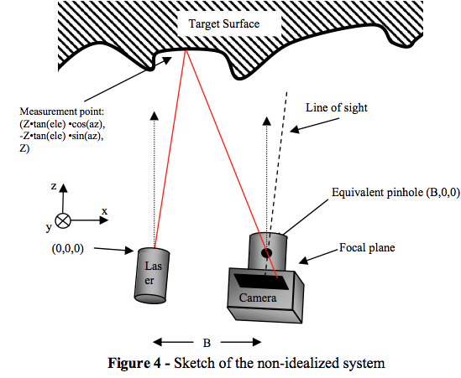
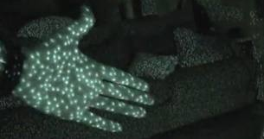
Kinect
Structured light: IR speckle pattern

Slide 21
ROS Distance Messages
sensor_msgs/LaserScan
http://docs.ros.org/api/sensor_msgs/html/msg/LaserScan.html
sensor_msgs/Range
http://docs.ros.org/api/sensor_msgs/html/msg/Range.html
sensor_msgs/PointCloud2
http://docs.ros.org/api/sensor_msgs/html/msg/PointCloud2.html

